Slide 1
Analysis of Data

Slide 2
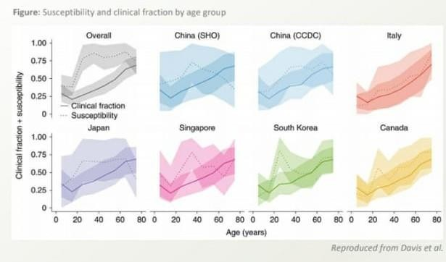
Susceptibility to COVID-19 rises with age
In transmission modals fitted to epidemic data from China, Itely,
Japan, Singapore, Canada & South Korea
The percentage of persons infected among the exposed (susceptibility) and the percentage with symptoms among those infected (clinical fraction) both generally increase with age.

Slide 3
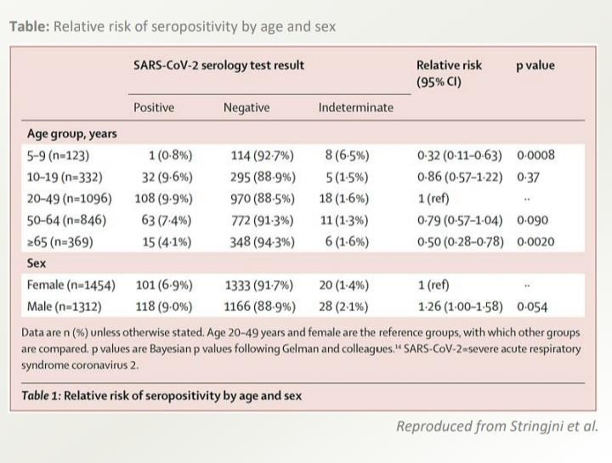
Fewer children under 10 have antibodies
compared to adolescents and adults
Seroprevalence study of SARS-CoV-2 IgG antibodies in Geneva (May 2020)
7.9% of the population of Genev a had
developed antibodies by May 9th.
Antibody prevalence was much lower in children aged 5-9 years and in adults 65 years or older than those aged 10-64 years.
This suggests fewer children under 10 had been infected.
Adolescents has a similar prevalence as
young adults.
Limitations :---
Sample only included children 5 years or older.
Younger children had a higher proportion of indeterminate test results.
The performance of the test is uncertain in children. The commercially available ELISA was only validated for adults.

Slide 4
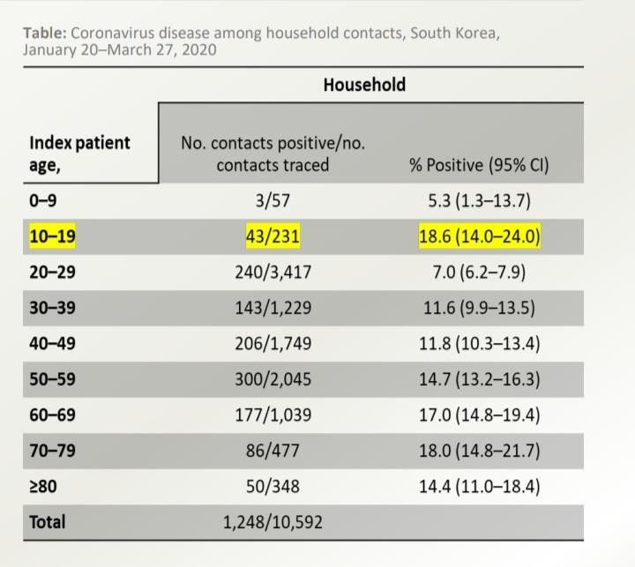
Children under 10 are less likely to pass on the
virus to other than adolescents and adults
A large contact-tracing study in the Republic of South Korea
Among 59,073 contacts of 5,706 covid-19 patients, 12% of household contacst tested positive for covid-19.
Only 5% of contacts of children aged 0-9 years become infected, the lowest for all age groups.
This suggests young children are less contagious than older children and adults.
Limitation :---
Direction of transmission was not rigorously documented, and this could account for significant bias.
Number of cases and contacts were very small in the younger age+groups.

Slide 5
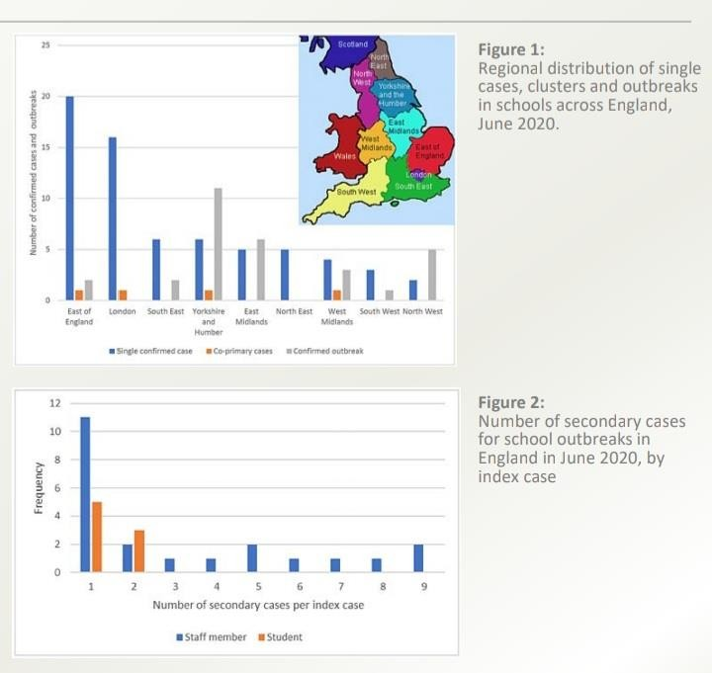
Limited SARS-CoV-2 infection in schools with public health measures
England, June-31 July 2020
Public Health England (PHE) initiated enhanced surveillance following the reopening of schools during a summer mini- turm on 01 June 2020.
Re-opening of schools was associated with few covid-19 outbreaks when public health measures were in place.
67 single confirmed cases, 4 co-primary cases and 30 covid-19 outbreaks during June 2020.
Strong correlation between number of outbreaks and regional covid-19 incidence.
Staff members had a higher risk of SARS-CoV-2 infection than students; most cases linked to outbreaks were in staff.
Additional interventions should focus on reducing transmission in and among staff members.

Slide 6
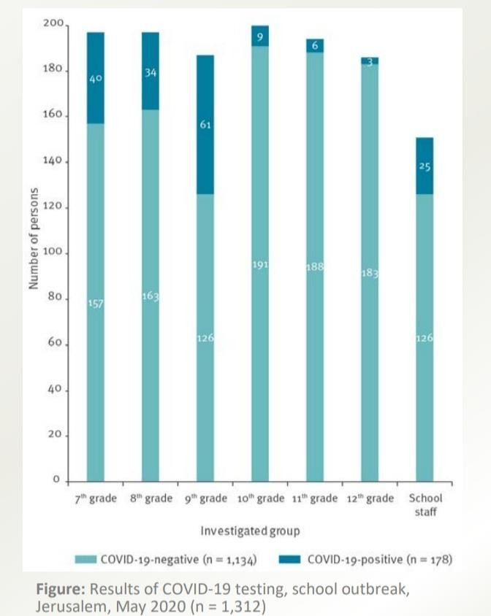
Large covid-19 outbreak in a high school
with insufficient public health measures
On 13 March 2020, Israel closed all schools ; then fully reopened on 17th May.
Measures included daily health reports, hygiene, facemarks,
social distancing and minimal interaction between classes.
On 19-21 May during an extreme heatwave, the Ministry of Health exempted pupils from wearing masks. Windows were closed and air-conditioning functioned continuously.
Ten days later, a major covid-19 outbreak occurred in a high school.
1,164 students (aged 12-18 years, grades 7-12) and 152 staff were tested.
178 confirmed cases : 153 students (Attack rate: 13%) and 25
staff (Attack rate:17%).
43% of student cases and 76% of staff cases reported symptoms.
Classes were reported crowded (36-38 students/ 39-49 m2).
It was concluded that public health measures were not adequate and contributed to the outbreak.

